Slide 1
“Cultural” Considerations
Pediatric Psychiatry ECHO Learning Collaborative
Amy M. Mayhew, MD, MPH
Child, Adolescent, and Adult Psychiatrist
December 4, 2024

Slide 2
Learning Objectives
Learners will have an understanding that there is more than one way to be in the world that is defined as "culture"
Learners will increase their awareness of the need for flexibility when managing patients with different paradigms
Learners will increase their curiosity about the lives and cultures of patients and their families and how it influences their health care

Slide 3
Definitions
Culture: patterns of human behaviors including thoughts, communication, actions, customs, beliefs, values, and institutions of a particular social group
Cultural curiosity/ competence: an ability to work effectively with individuals or different cultural backgrounds
Acculturation: assimilation to a different culture, generally the dominant one
Ethnicity: common historical, geographic and/or cultural heritage shared by a group of people
Race: a social classification based on external physical characteristics that hold specific social significance within a culture
Immigrant: someone who intends to live within a new land/ culture

Slide 4
What group constitutes a ‘culture?’
an occupation (military, doctors, teachers, farmers)
a location (New Englanders, Floridians, Texans)
a sports team (Giants, Patriots, Cowboys, Gators)
a religion (Evangelicals, Catholics, Baptists, aetheists)
an ethnic group (Haitians, Dominicans, Mayans, Ibo)
a language (Spanish, English, Dutch, Arabic, Hindi, Swahili)
a racial group (of note, often defined by the majority culture)
Gender or sexual orientation
and others…

Slide 5
Being a clinician is a place of privilege

Slide 8
Peace Corps: a bedeshi in Nepal, 1997-99

Slide 9
Peace Corps goals as health care providers
To help the people of interested countries in meeting their need for trained men and women (“clinical service”)
To help promote a better understanding of Americans on the part of the peoples served (“understanding of our assimilated doctor culture”)
To help promote a better understanding of other peoples on the part of Americans (“understanding the culture of our patients”)

Slide 10
A Stranger in a Strange Land-bedeshi style
As a Hindu country, caste is an important concept and how it impacts many aspects of life—how to navigate as a non-Hindu?
Meetings often take place two hours after you think they do
As a woman in a traditional patriarchal society, do you have more influence with women or men?
How to honor local traditions and still be true to yourself
Relationships are key to everything
Relationship forming in Nepal means many cups of tea (up to 12 per day)

Slide 11
A sailboat in the Bahamas- mini me

Slide 12
A Stranger in a Strange Land-boating style
Much is dictated by the weather
Boaters often have side jobs to keep boating, which means there are periods of time in one port and other periods of travel
There is often a circle of trust amongst boaters-because you need each other
Division between ‘motorboat’ and ‘sailboat’ people
Various locations view you as an outsider, except for those in the boating culture
Transient nature of life in different locations-forming lasting connections
Cramped quarters and considerations for relationships

Slide 13
The invisible U.S. ‘culture’ of white ethnic people

Slide 14
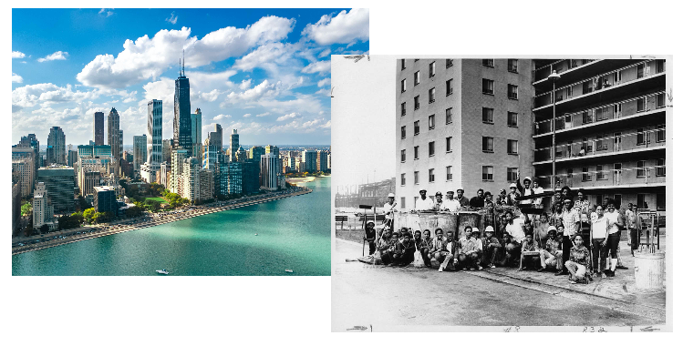
Chicago- a tale of many cities

Slide 18
Cultural example- Maine fishing family
European-American male middle school student
Father is multi-generational Maine lobsterman, patient, siblings, and family live on an island
Patient goes to school on the mainland and takes the ferry daily
“1950s” values of family roles, interactions, hierarchy
Limited interactions with non-island families and children his age outside of school
Other relatives live on the island in close quarters
Family not big believers in mental health care or treatment even though patient on an IEP for anxiety and ADHD

Slide 19
Considerations-Maine fishing family
Logistical considerations of getting on and off the island
Respecting culture of family of origin but also promoting treatment of mental health issues
Insular nature of island and fishing life contrasted with a diverse school population
Navigating social mores in a wider social pool versus a narrow familial one
Gender and relationship roles

Slide 20
Cultural example-first generation immigrant
Young adult female South Sudanese college student
Youngest of many siblings, only one born in the United States
Other siblings born and lived for years in a refugee camp in Uganda
Father speaks multiple languages, including English, mother speaks local language, one other language and not English
Siblings often speak to each other in Arabic or local language
Patient only speaks English
Family is evangelical, patient is not
She and one other sibling in college
Family does not believe in mental health care or treatment even though schizophrenia runs in the family

Slide 21
Considerations-first generation immigrant
Expectations of being the only American-born
Being truly bi-cultural, but not belonging to either
Family history of trauma and how that effects functioning
Language issues
Identity issues related to race, ethnicity, religion, and language, as well as first-generation status and college student
Finding a place to feel understood

Slide 22
Cultural Considerations
Understanding of presenting problem and what the solution may be
Collectivist vs. individualistic culture-who should be in the room?
Financial, transportation and time constraints
Understanding of time and appointments as a fixed point in time
Place in the social hierarchy and privilege
Time needed to build trust in a relationship
Stereotypes and prejudices particular to certain groups that may influence trust
Immigration story and relation to that story if pertinent

Slide 23
Cultural Considerations
Negotiate boundaries and treatment parameters
Language concerns
Perceptions of clinicians and hierarchy
Cultural explanations of mental health and illness
Religious mores
Connection to traditional healers/cultural brokers (including the patient and family)
Use of alternative medicines and herbal remedies (including cannabis)
Exploration of one’s own culture and bias-being open to being wrong

