Slide 1
Collaborative Safety Planning
Working with Families to Engage
in Planning for Safety
Sheila Nelson and Greg Marley

Slide 2
A safety plan is a written list of coping skills & activities as well as personal, social and professional resources developed with a person, for use during and after a crisis:
Focus on personal coping skills and activities,
Exploration of personal and social resources and the ability to mobilize them, including family supports, friends,…
Focus on professional supports and other resources,
Opportunity to plan for lethal means safety
Make a copy for the person and keep one for follow-up.
* Safety plan handout
Collaborative Safety Planning
Notes:
Presenter
2021-09-15 15:59:05
--------------------------------------------
For a patient returning home with any level of distress or low suicidal risk, developing a safety plan is an important exercise in assessing the person’s ability to engage in a process of developing a safe net for themselves. The planning process is also a valuable tool for use when someone returns to the community following a crisis or hospitalization. Safety planning involves the client in a process of identifying triggers for increased risk and also the personal, social and professional resources that can be activated to manage any distress. The WICHE Toolkit includes an excellent template for safety planning and also walks a practitioner through the process for developing the plan.

Slide 3
The next crisis happens when they are not with professional help!
How can a patient manage a suicidal crisis as it develops?
We can work with a patient to support their ability to manage through a crisis before it happens or as it develops!
How can we empower them to identify and activate resources available to them.
This is empowerment for the individual and the family.
The Challenge
Notes:
Working to plan and prevent the next crisis.

Slide 4
Their plan in their words accessing their resources.
Sit with the patient and family
Use their language
Short sentences and phrases
Encourage them to do the writing
Never a plan developed for them; always with them!
Steps to Collaboration
Notes:
Working to plan and prevent the next crisis.

Slide 5
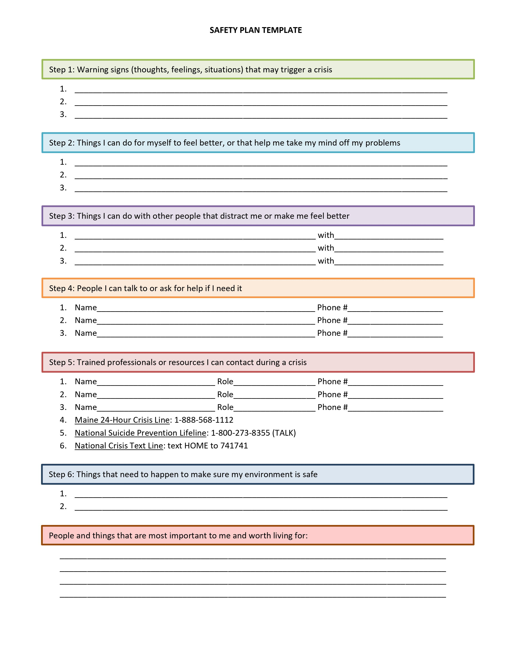
Notes:
Template, Maine Specific version available. Will dig into each section upcoming

Slide 6
Notes:
Ask them to fill out their own Safety and/or wellness plan! (come back to this in in person session?)
Should include #s for resources to help on Safety plan! (see end of presentation for full list or attached).
See resources for template with Maine specific resources included.

Slide 7
Notes:
Ask them to fill out their own Safety and/or wellness plan! (come back to this in in person session)
Should include #s for resources to help on Safety plan! (see end of presentation for full list or attached).
See resources for template with Maine specific resources included.
Safety plans can be kept as a physical copy (paper), on an app, picture on phone, etc. Somewhere where the client will have access when they need it. Best decided with them.
Talk more about step 6 specifically in the following slide RE: Lethal means safety

Slide 8
Conversations with youth and families about Lethal Means Safety Interventions

Slide 9
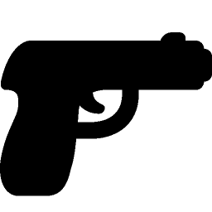
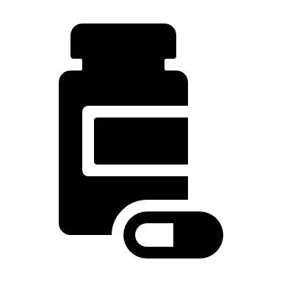
Firearm/Weapon Safety
Start from a common purpose
Present a menu of options
Take a harm reduction approach
Provide problem-solving strategies in advance
Medication Safety
Supervision
Notes:
Remember that there can be stigma associated with suicide, substance use, firearms, and lethal means, so the approach you take is key to success
Consider approach you would take with someone who has been drinking and wants to drive- take their keys, because this reduces a bad outcome in the face of a volatile situation
LMSC can be addressed as a primary prevention approach, developing a plan prior to a crisis happening (PH approach is preventing suicidal behaviors before they occur)
- help the client to identify other reasons for separating themselves and the lethal means- children at home, pets, neighbors
Taking the time to understand why owning a firearm is a priority for someone- there are many reasons such as self protection, recreation/hobby, family tradition and bonding experience
- Be open to discussing specific threats/concerns of the client
- Discuss the realistic risk of home invasion crimes
- Consider other means of protection- alarm system, dog, flood lights etc.
- What steps can the person take to mitigate suicide risk

Slide 10
Starting the Conversation
I know that you love your child, and you are worried about keeping them safe. There are some strategies you could use to help protect them until they’re feeling better. Would it be okay if we talked about those options?
Sometimes when youth are struggling with their mental health, families will ask someone they trust to hold on to their firearms until their child is feeling better. Storing weapons out of the house is one of the safest options – is that something you’d consider?
Notes:
Start with identifying what is important to youth and caregivers
Recognize that a young person may not have ultimate control over firearm safety measures in their household. If young person and caregivers have different safety goals, strategize a compromise if possible, and work with youth on other forms of safety planning.

Slide 11
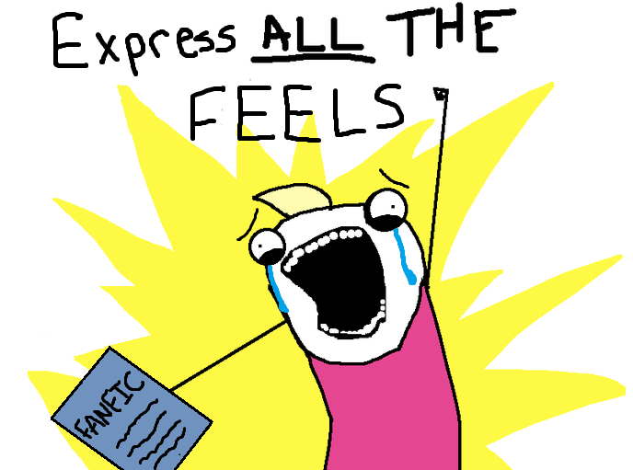
Developmentally Appropriate Conversations
Adolescents are rapidly maturing in the “feeling” sections of the brain
Have less “wiring” connecting the feeling brain with the planning/inhibitory brain
May make it especially likely for youth to take actions based on heightened emotional states
Provide context without minimizing or dismissing the lived experience of youth
Notes:
Giving choices, very important to include young people in the planning, and explaining what's happening
**Resource for language: https://www.mirecc.va.gov/visn19/talk2kids/docs/Talk2Child_color.pdf

Slide 12
Collaborative Safety Planning is Valuable For:
Anyone identified as at risk for suicide
Anyone with identified risk who is transitioning levels of care
Someone in an extended inpatient or residential stay or shelter
Someone with crisis developing:
Engages the person on their own behalf.
Supports self-management
Tracks progress
Notes:
Can also be called a wellness plan and can be used by anyone – try to make your own!

Slide 13
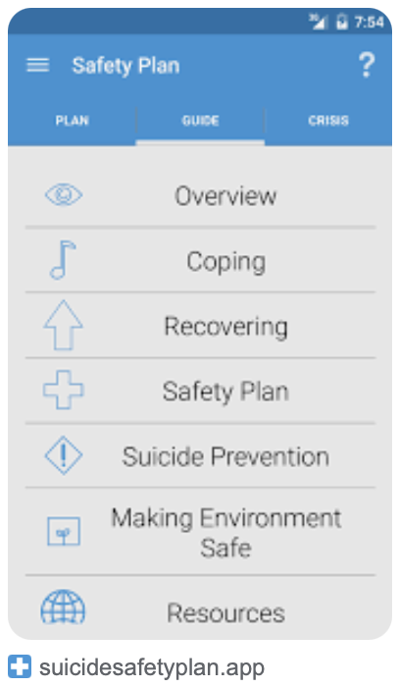
Crisis Plan Apps

Slide 14
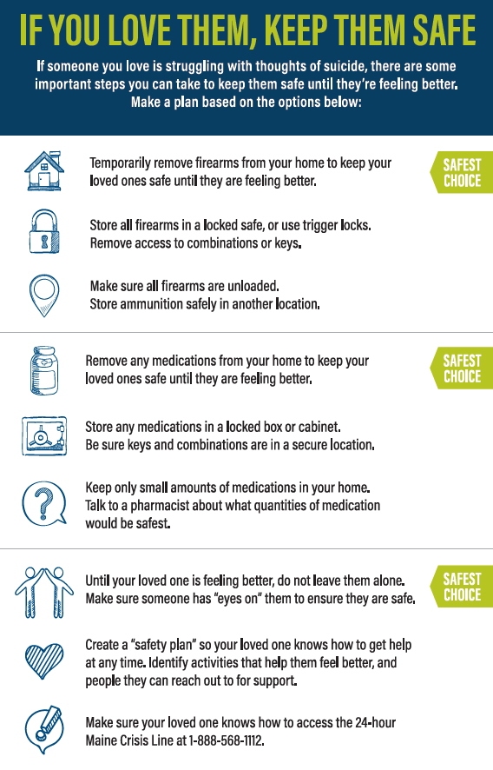
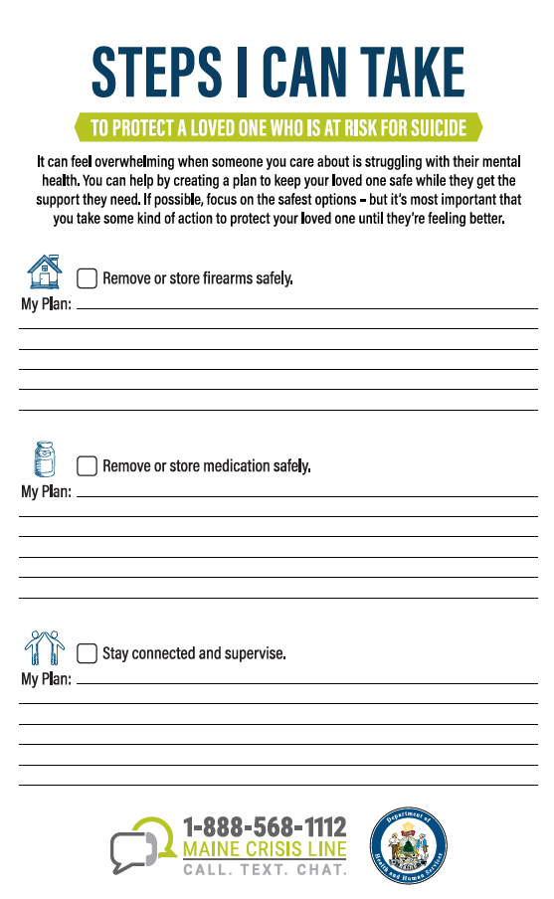
Suicide Prevention Safety Card
Available on the Maine Prevention Store

